Slide 1
Yaml basics

Slide 2
Explain about
What is yaml
Key-value
List/array
dictionary/map

Slide 3
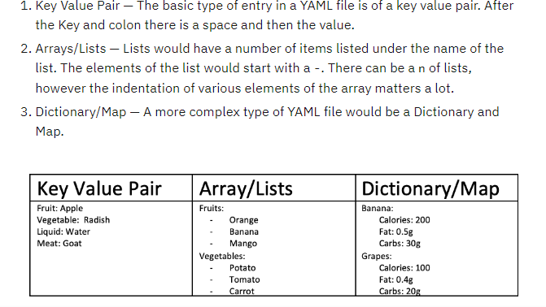
Yaml example

Slide 4
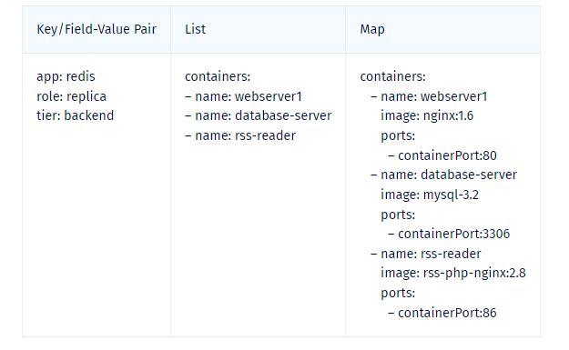
Yaml in k8s

